Slide 1
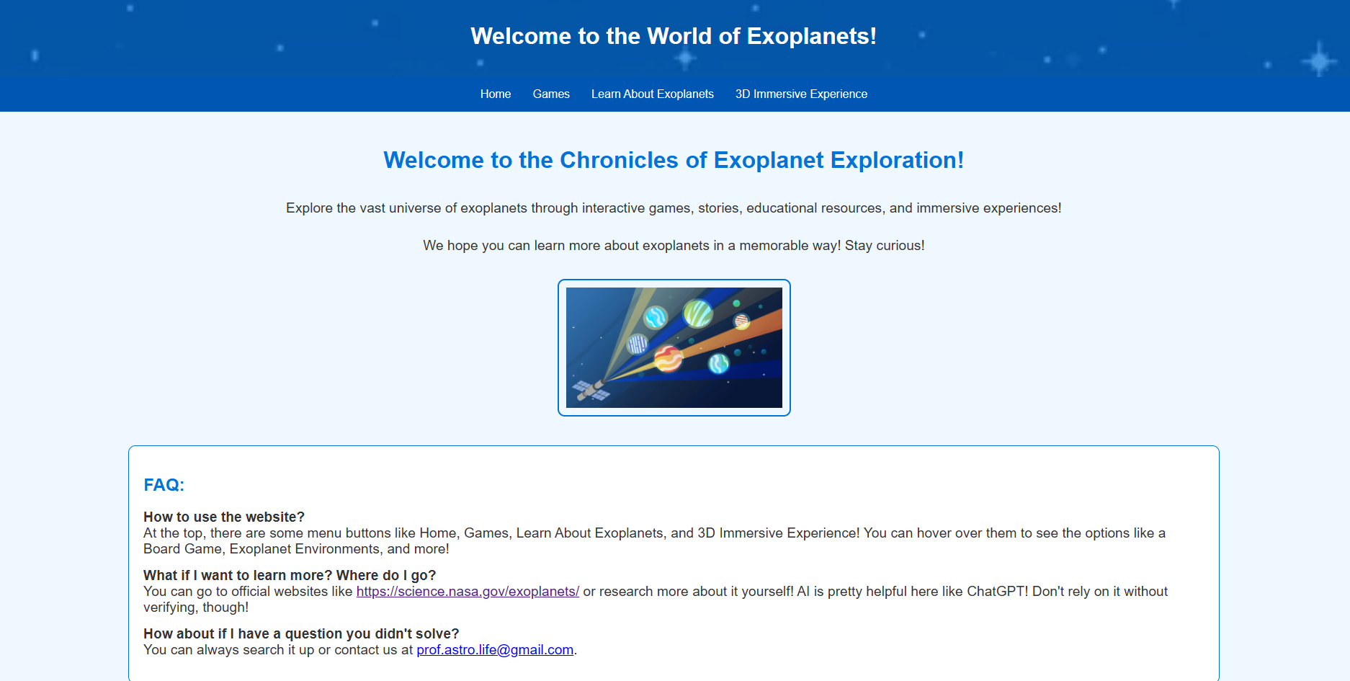
Chronicles of Exoplanet Exploration
Team - ExoplanetChronicles, Members - Aeparish M, Amia L, Aepkrish M
Live website - https://auroralynx.github.io/ExoplanetChronicles/

Slide 2
Flow of the presentation:
Usecase:
We’ve created a website which hosts interactive games, a printable board game and 3d immersive experiences and resources from NASA so that people can learn about exoplanets while enjoying and generating curiosity to dig deeper further via the resources on the website.
In this presentation on each slide, we are covering one aspect of our website.
We’re targeting kids from elementary and middle school because these are the ripe time kids develop their thoughts and understanding.
We hope to achieve bridging educational gaps and provide opportunities for kids who may not have access to engaging learning tools and hope to make knowledge accessible to everyone, regardless of background. We are providing interactive tools like games and printable learning material and board games so that underserved kids can learn as well as normal kids.
Our Board game is easily printable and affordable to underprivileged children, and partnering with public schools and NGOs will ensure it serves as an educational tool while remaining affordable and accessible for communities in need.
This can help grow children's interest in Exoplanets, and celestial objects outside our solar system.

Slide 3
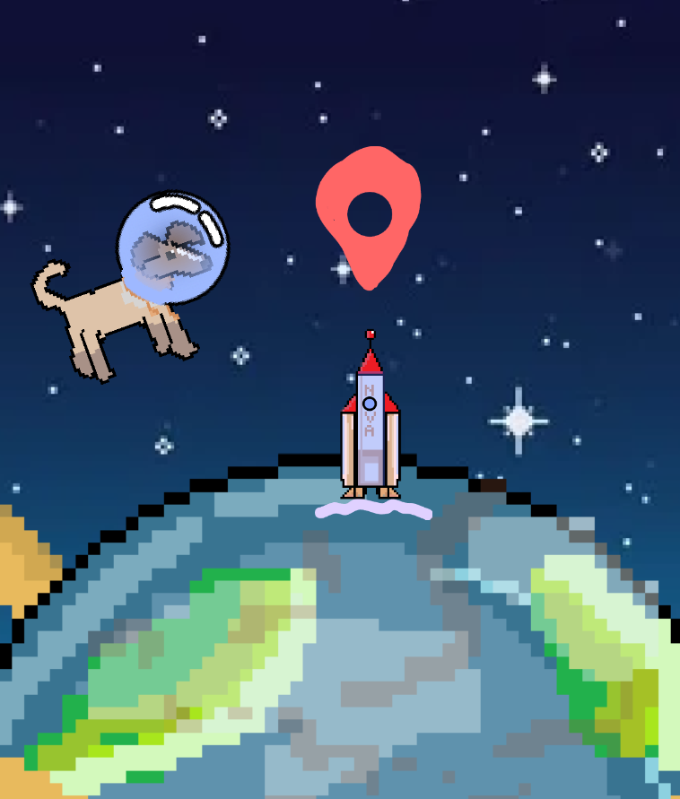
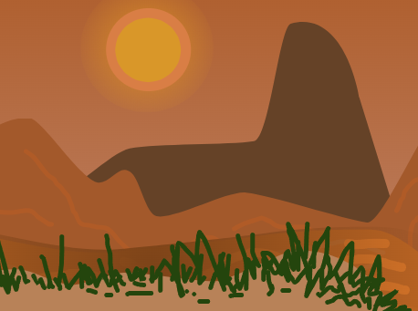
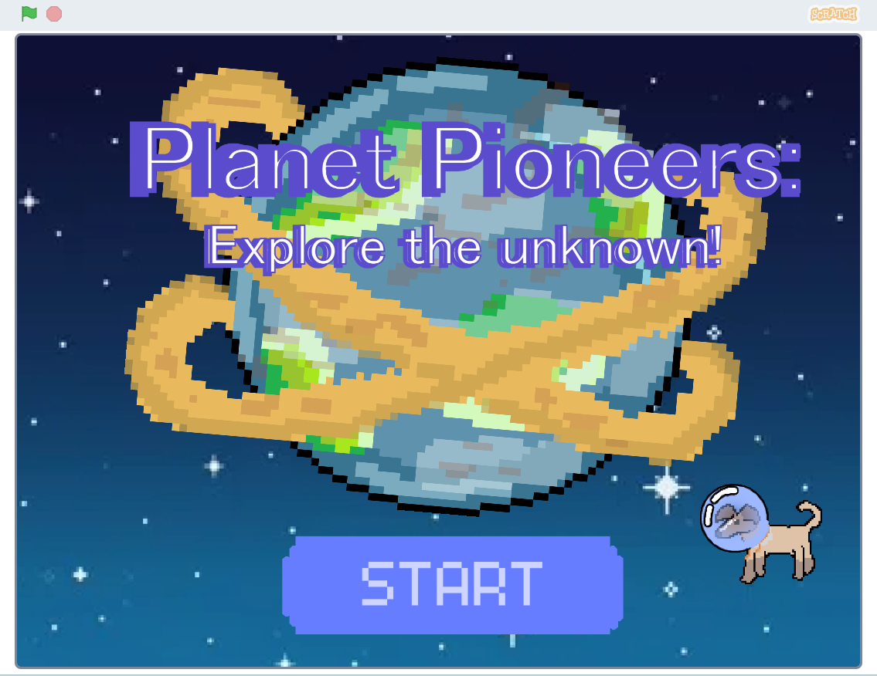
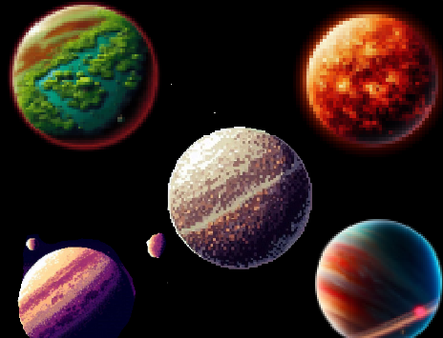
PLANET PIONEERS: EXPLORING THE UNKNOWN!
In Planet Pioneers, users embark on an exciting journey through exoplanets, starting from Chrysomedak, the home planet of Laika, a cloned space dog. They explore different exoplanets, in a thought-provoking and engaging way. *At present the only exoplanet which a world/parallax has been made for to be explored is kepler 186f. It can also work on phone.
Future Improvements: Adding activities like rocket speed boosts, alien communication, and more levels would enhance interactivity. Improved animations and storytelling would further enrich the experience.

Slide 4
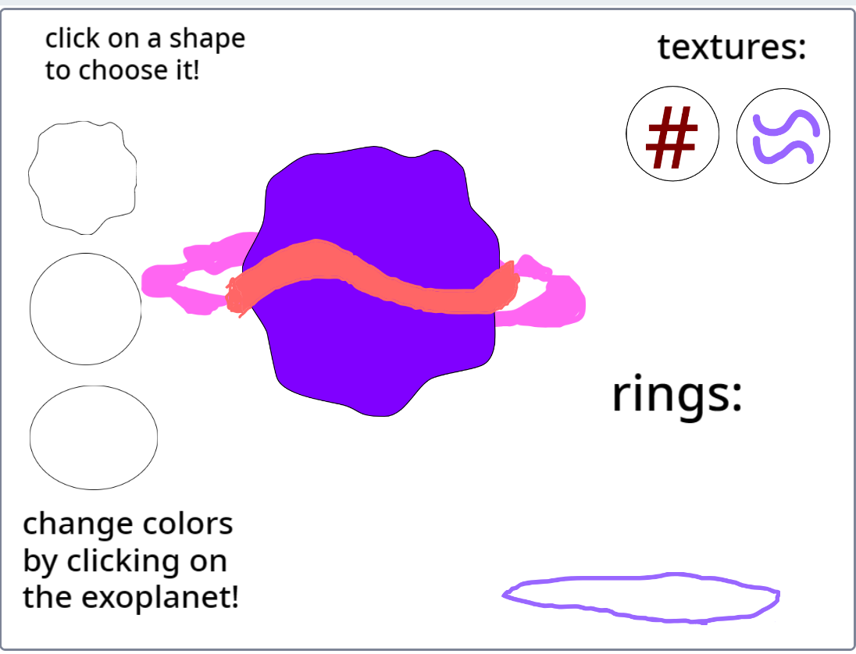
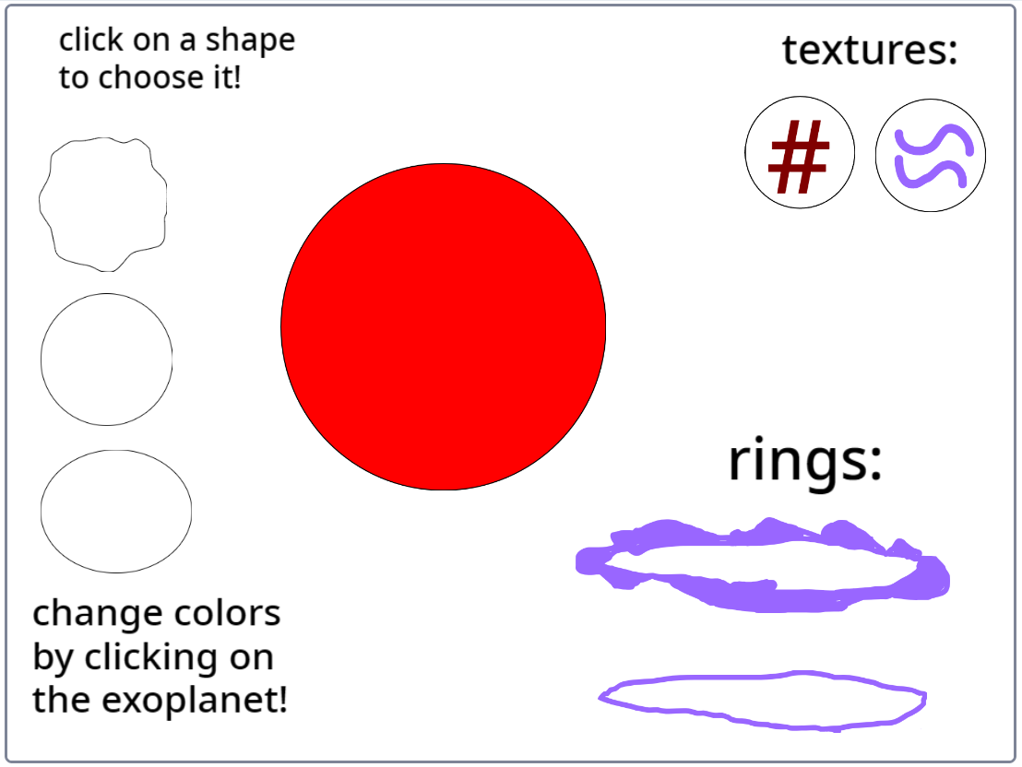
EXOPLANET CREATOR Made by our 7 year old teammate (Aepkrish)
You can make your own exoplanet which includes colors, shapes, textures, rings, and more. It was made for elementary level kids mainly so that they can enjoy in an interactive way while nurturing their creativity. Some more things to be included in the future are more options of customising your own exoplanet and maybe even options to draw your own ideas!
Customised:
When started:

Slide 5
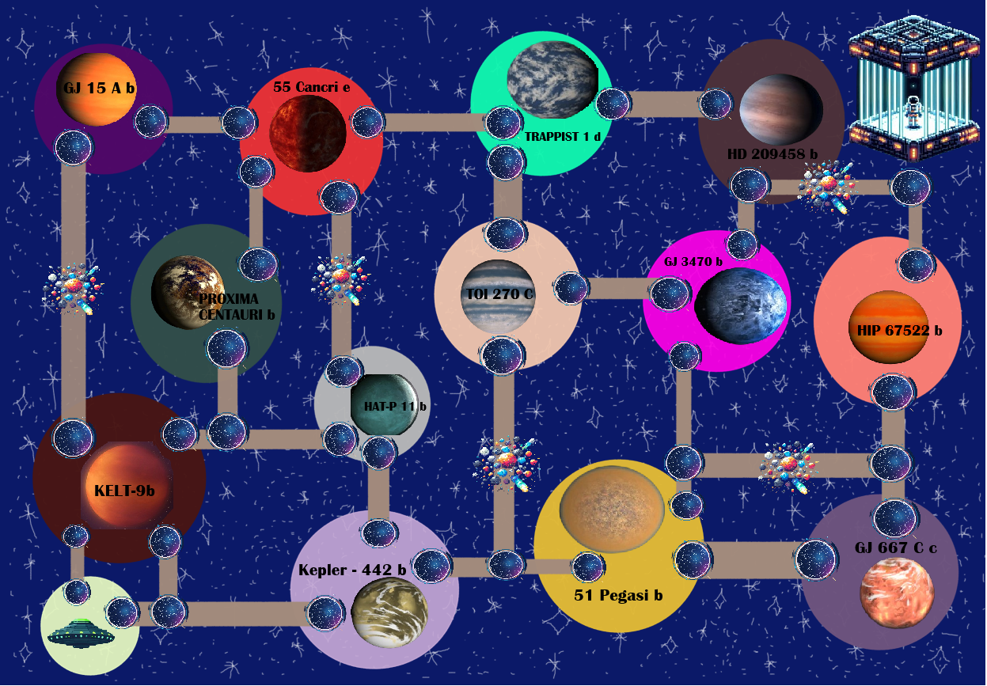
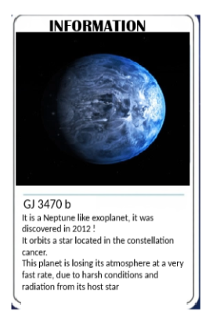
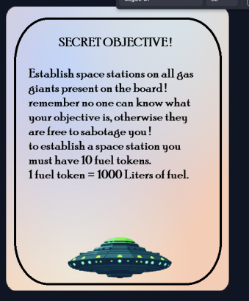

GALACTIC SETTLERS : THE RACE TO THE EXOPLANETS!
In "Galactic Settlers", players are space explorers discovering and settling distant exoplanets, trading resources, and encountering challenges along the way. Each player starts with 5 fuel tokens, a secret objective, and selects a figure to represent them. They move from one space portal to another.
When a player purchases an exoplanet or builds a space station, they share information about that planet with others. If they land on a cosmic storm they go to jail. The game ends when a player completes their secret objective or garners the most resources.

Slide 6
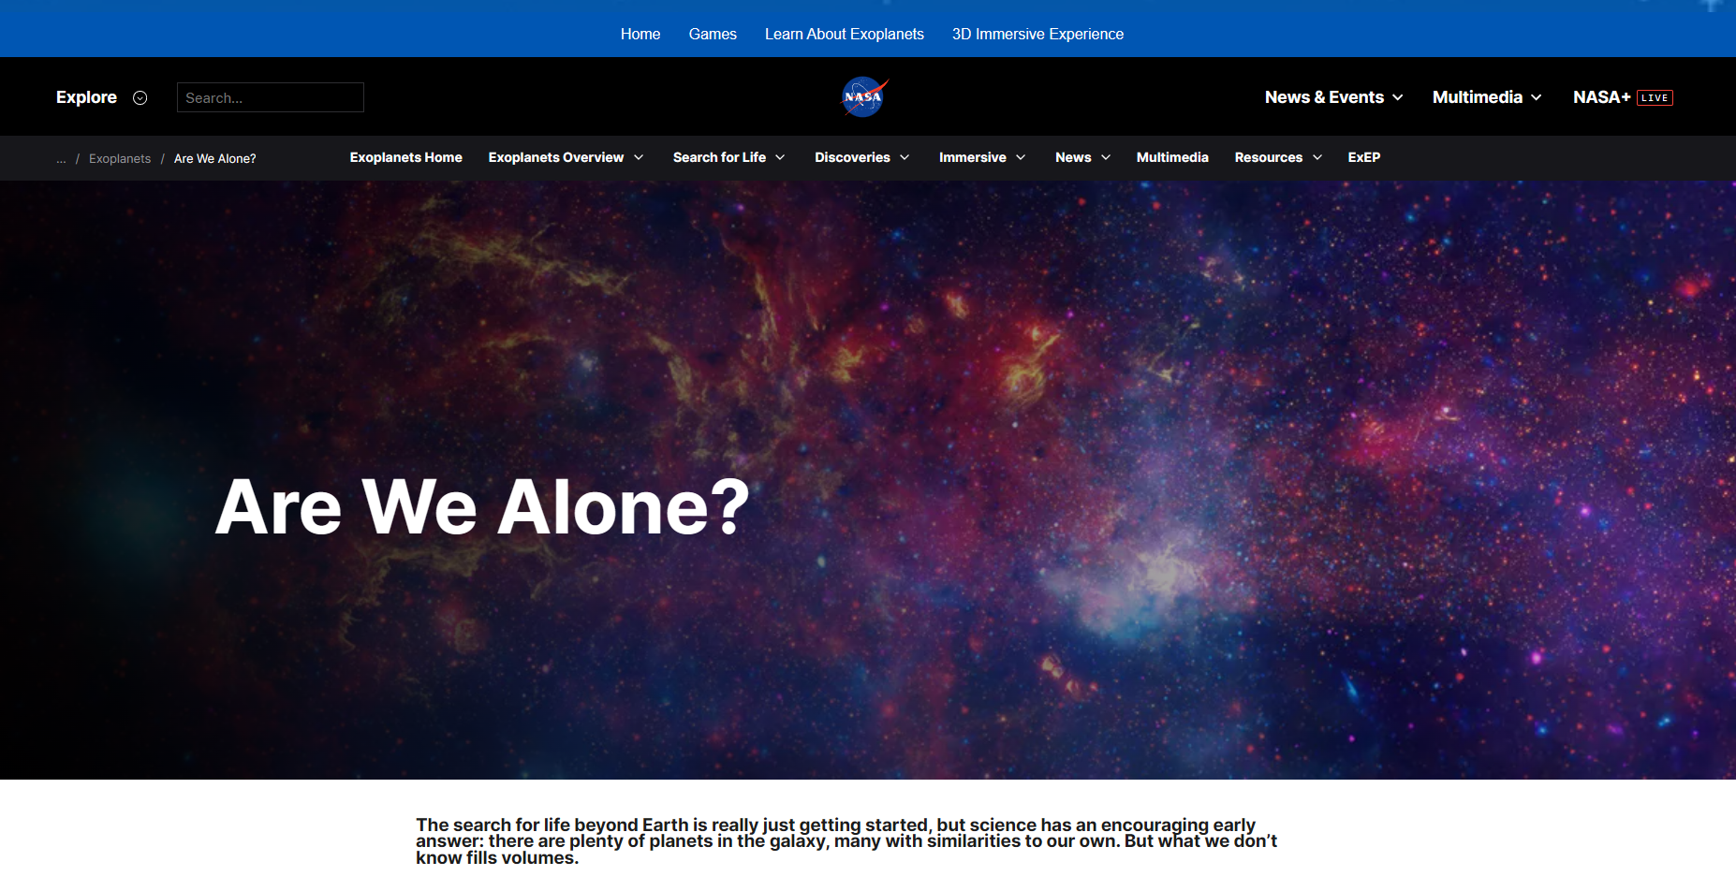
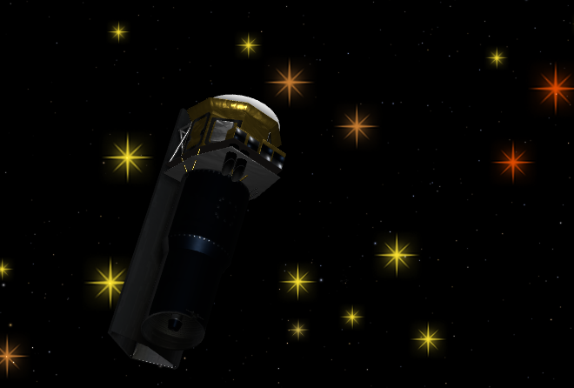
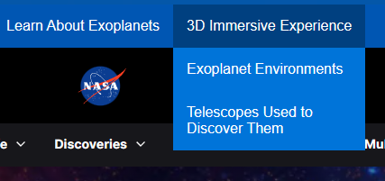
Learning and immersive tools:
We made use of NASA’s resources to the fullest and included 3D experiences using the exoplanet travel bureau finding the space telescope and exoplanet surface imaging made by an artist’s impression. We added websites to show the exoplanet catalogues and types to provide more information and encourage learning.

Slide 7
Resources:
https://science.nasa.gov/exoplanets/ <- main reference
Exoplanet Catalog - NASA Science
Exoplanet Travel Bureau | Explore – Exoplanet Exploration: Planets Beyond our Solar System (nasa.gov) <- sites in this
Are We Alone? - NASA Science
Overview - NASA Science
Chatgpt to help with the website code, copilot to generate few images. (some hand drawn like Laika, the planet Chrysomedak and rocket)

